Slide 1

COUPLE TEST
Understand & accept each other

Slide 2
Initial Aim
To develop an app that helps couples:
-identify,
- understand
and accept their differences
This is because personality type is a big contributor to conflicts.

Slide 3
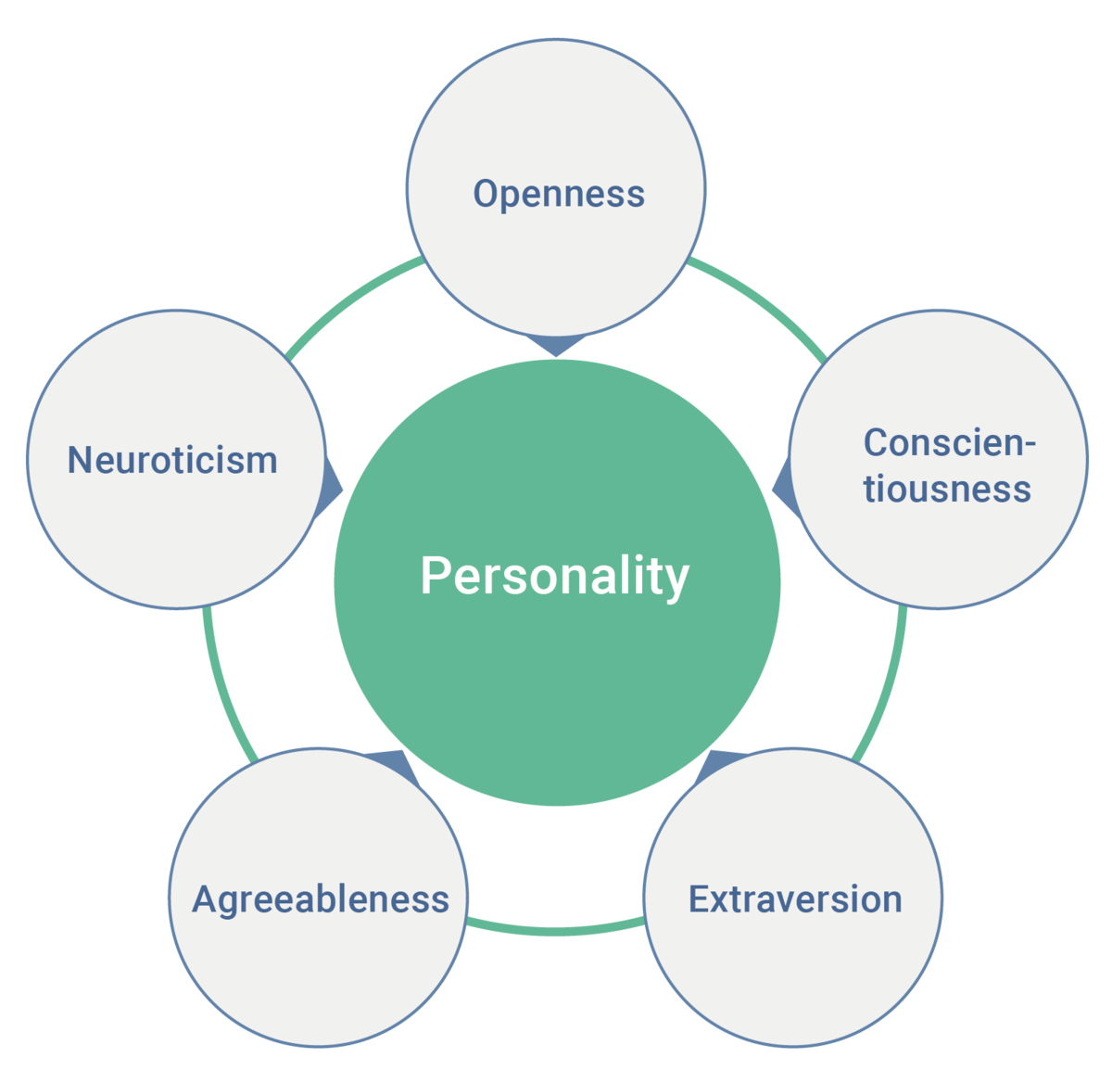
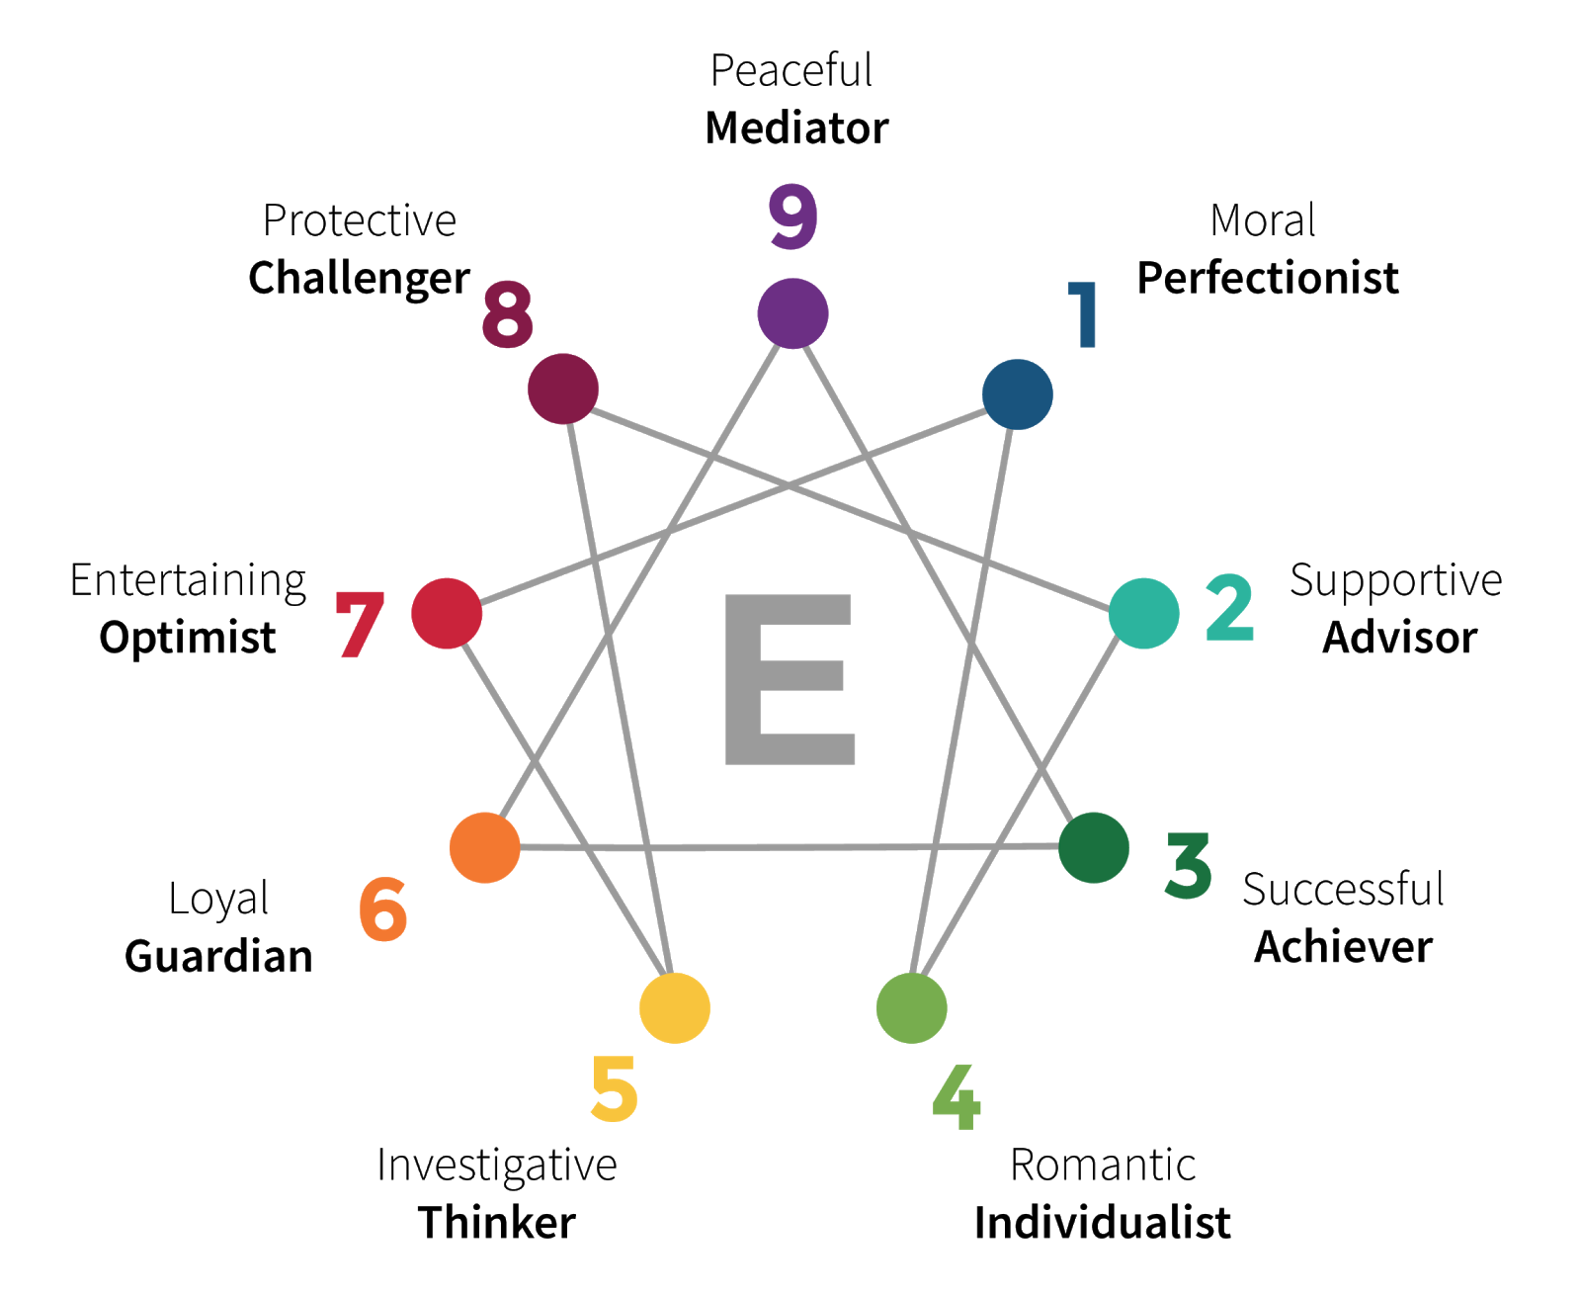
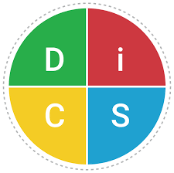

Methodology
To create a machine learning algorithm that is trained using survey data.
The survey is built like a personality test evaluator
Following a similar logic to MBTI, Enneagram, Big Five and DISC

Slide 4
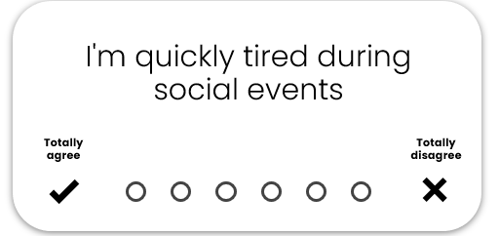
Survey Tool
Initially the survey took several hours to complete with participants asked to rate both assertions and tips.
In order to reduce the size of the survey we conducted Multiple Component Analysis (MCA) in R
MCA were used to identify significant variables associated with the Couples.
MCA is a branch of Correspondence Analysis (CA) which houses a family of descriptive methods that allow one to analyse patterns among several categorical dependent variables (Abdi & Valentin, 2007).
MCA can be applied to datasets that contains both qualitative and quantitative variables. It is an opportunity to group observations with similar characteristics and identify associations between variable categories (Kirthana, 2020).
It is widely used to reveal these relationships in complex dataset, on a multidimensional space which lets you visualize the trends graphically (Sourial, et al., 2010).

Slide 5
Survey Tool
technique for behavioral data that has been collected using Likert scales.
This resulted in 20 questions.
I spent time with the psychologist on the team to ensure that the questions cover all the different personality types.
Of the 20 questions only two MBTI groups were not covered namely: intuition and judgement

Slide 6
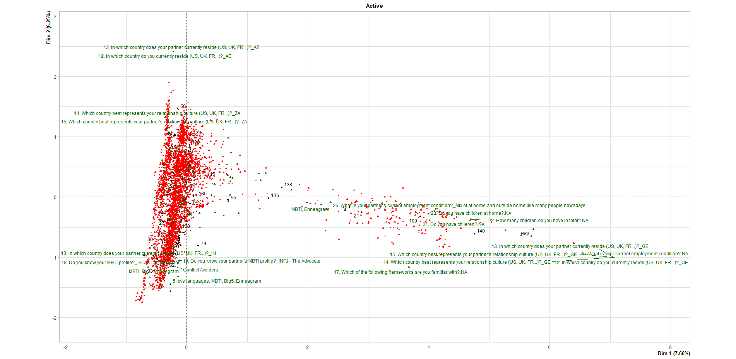
Survey Tool
1. I am capable of getting into fights easily and can be aggressive.
2. I like to have the choice until the last minute
3. I like to charm and seduce
4. I often think and suffer from negative things that might happen.
5. I am not very attentive to the negative emotions I arouse in others.
6. I don't like theories unless they have practical and direct applications.
7. I worry a lot about the future or upcoming events.
8. I am a reasonable and rigorous person.
9. I have a tendency to over-idealize or devalue the people around me.
10. I like to be an observer.
11. When I start speaking I don't always know what I am going to say.
12. I have a tendency to be dramatic in expressing emotions.
13. I tend to speak up before I am given the floor.
14. I have few friends and do not bond easily.
15. I tend to be suspicious of other's intentions.
16. I am very concerned about my appearance.
17. I handle criticism very badly.
18. I am often tense, even physically.
19. I like intimate and deep conversations.
20. I tend to express myself when asked questions rather than spontaneously.

Slide 7
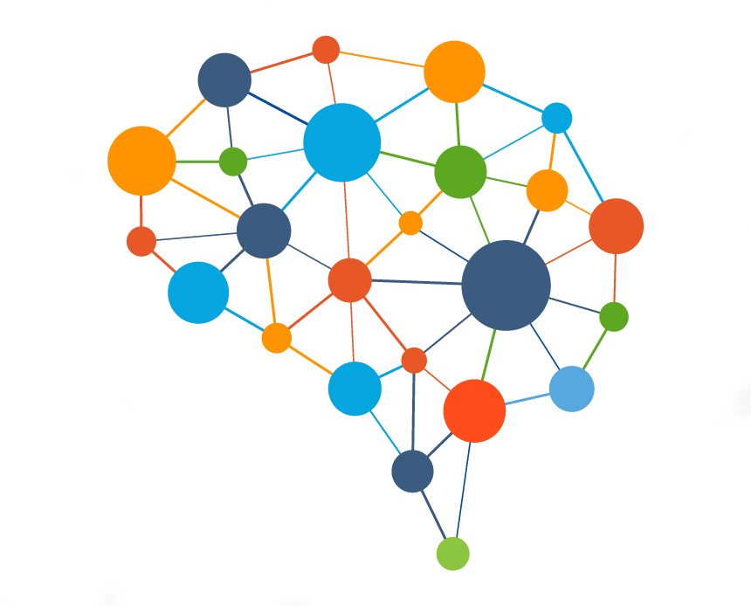
Modeling
Once narrowing down the survey questions, we moved onto exploring possible machine learning models.
We landed on - KNN
- Item based collaborative filtering
For the purpose of this presentation, we have chosen to present the KNN model. Unsupervised learning finding similarities between tips/assertions.
Pros : Easy to implement, Robust, handles continuous and discrete data
Able to make real-time prediction.
Can handle small data sets.
Noise free, with no training step.

Slide 8
Modeling
In the first step was to explore the tips dictionary that was shared by the psychologist.
We then selected tips that correspond with the 20 questions that were selected.
Because both tips and questions were rated by the participants.
We feed this information into our model to explore recommendations.

Slide 9
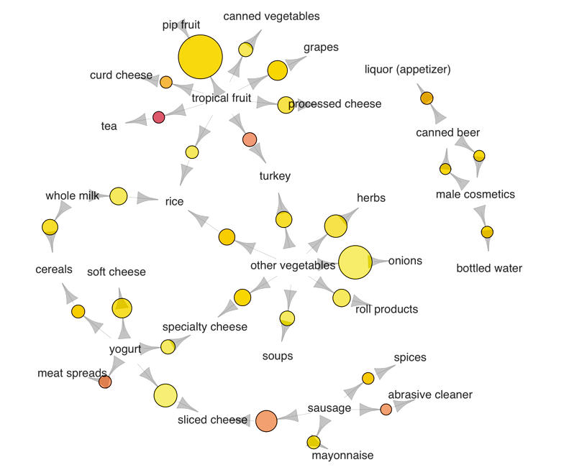
Findings
Given that the data set was small
We decided to merge the two sub data sets into one (df_ratings & df)
We grouped the Assertions and tips to find the highest ratings.
And find the mean of the ratings
We displayed one histogram with the percentage of ratings and we that 0,8 had the highest rating.
We then took the highest rated tip, using popularity threshold.
Then we saw that only one tip was the most popular across the participants
Namely: “Stay guarded but also leave room for your partner to know you more”
KNN was then implemented to find the similar tip that we can recommend.
The result: None, we couldn’t find a similar tip

Slide 10
Conclusion & Suggetions
The client posed a very challenging question that requires a mixed model approach.
This requires a data science subject matter expert.
However, we were able to build a model that draws correlations between both assertions and tips and finally recommend a tip.
In future we might need a bigger data set that is more representative of different personalities.
The model also showed that there was not much correlation between the questions.
The survey design might need improvements.

Slide 11

THANK YOU

